Slide 1
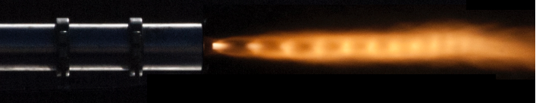



Characterizing the Effects of Aging on HTPB Hybrid Rocket Fuel
25th Annual Arizona Space Grant Consortium
William Templeton
Mentor: Dr. John Rajadas

Slide 2
Overview
Objective
Hybrid Rocket Engine
Fuel Casting Procedure
Hybrid Test Cart
Data Acquisition
Hot-Fire Testing
Results

Slide 3
Objective
Determine a shelf life for HTPB (hydroxyl-terminated polybutadiene) hybrid rocket fuel by analyzing its performance degradation.
Analysis of Performance:
Thrust Produced
Mass Flow Rate
Regression Rate
The performance degradation is defined as a significant change in any of the listed properties.

Slide 4
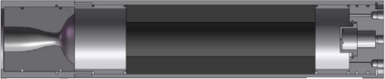
Hybrid Rocket Engine Overview
Oxidizer Inlet
Forward Closure
Nozzle
Post-Combustion Chamber
HTPB Solid Fuel
Pre-Combustion Chamber
Pros and Cons of Hybrid Rocket Engines:
Unstable Burns
Low regression rate
Oxidizer/fuel ratio shift
Throttleable
Mild failures
Safe handling and storage

Slide 5
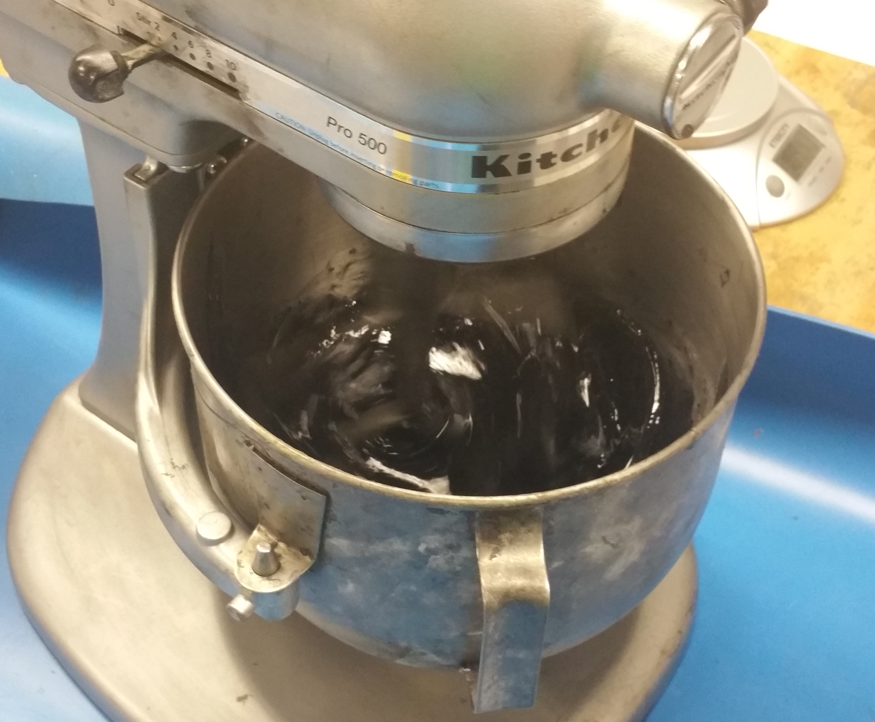
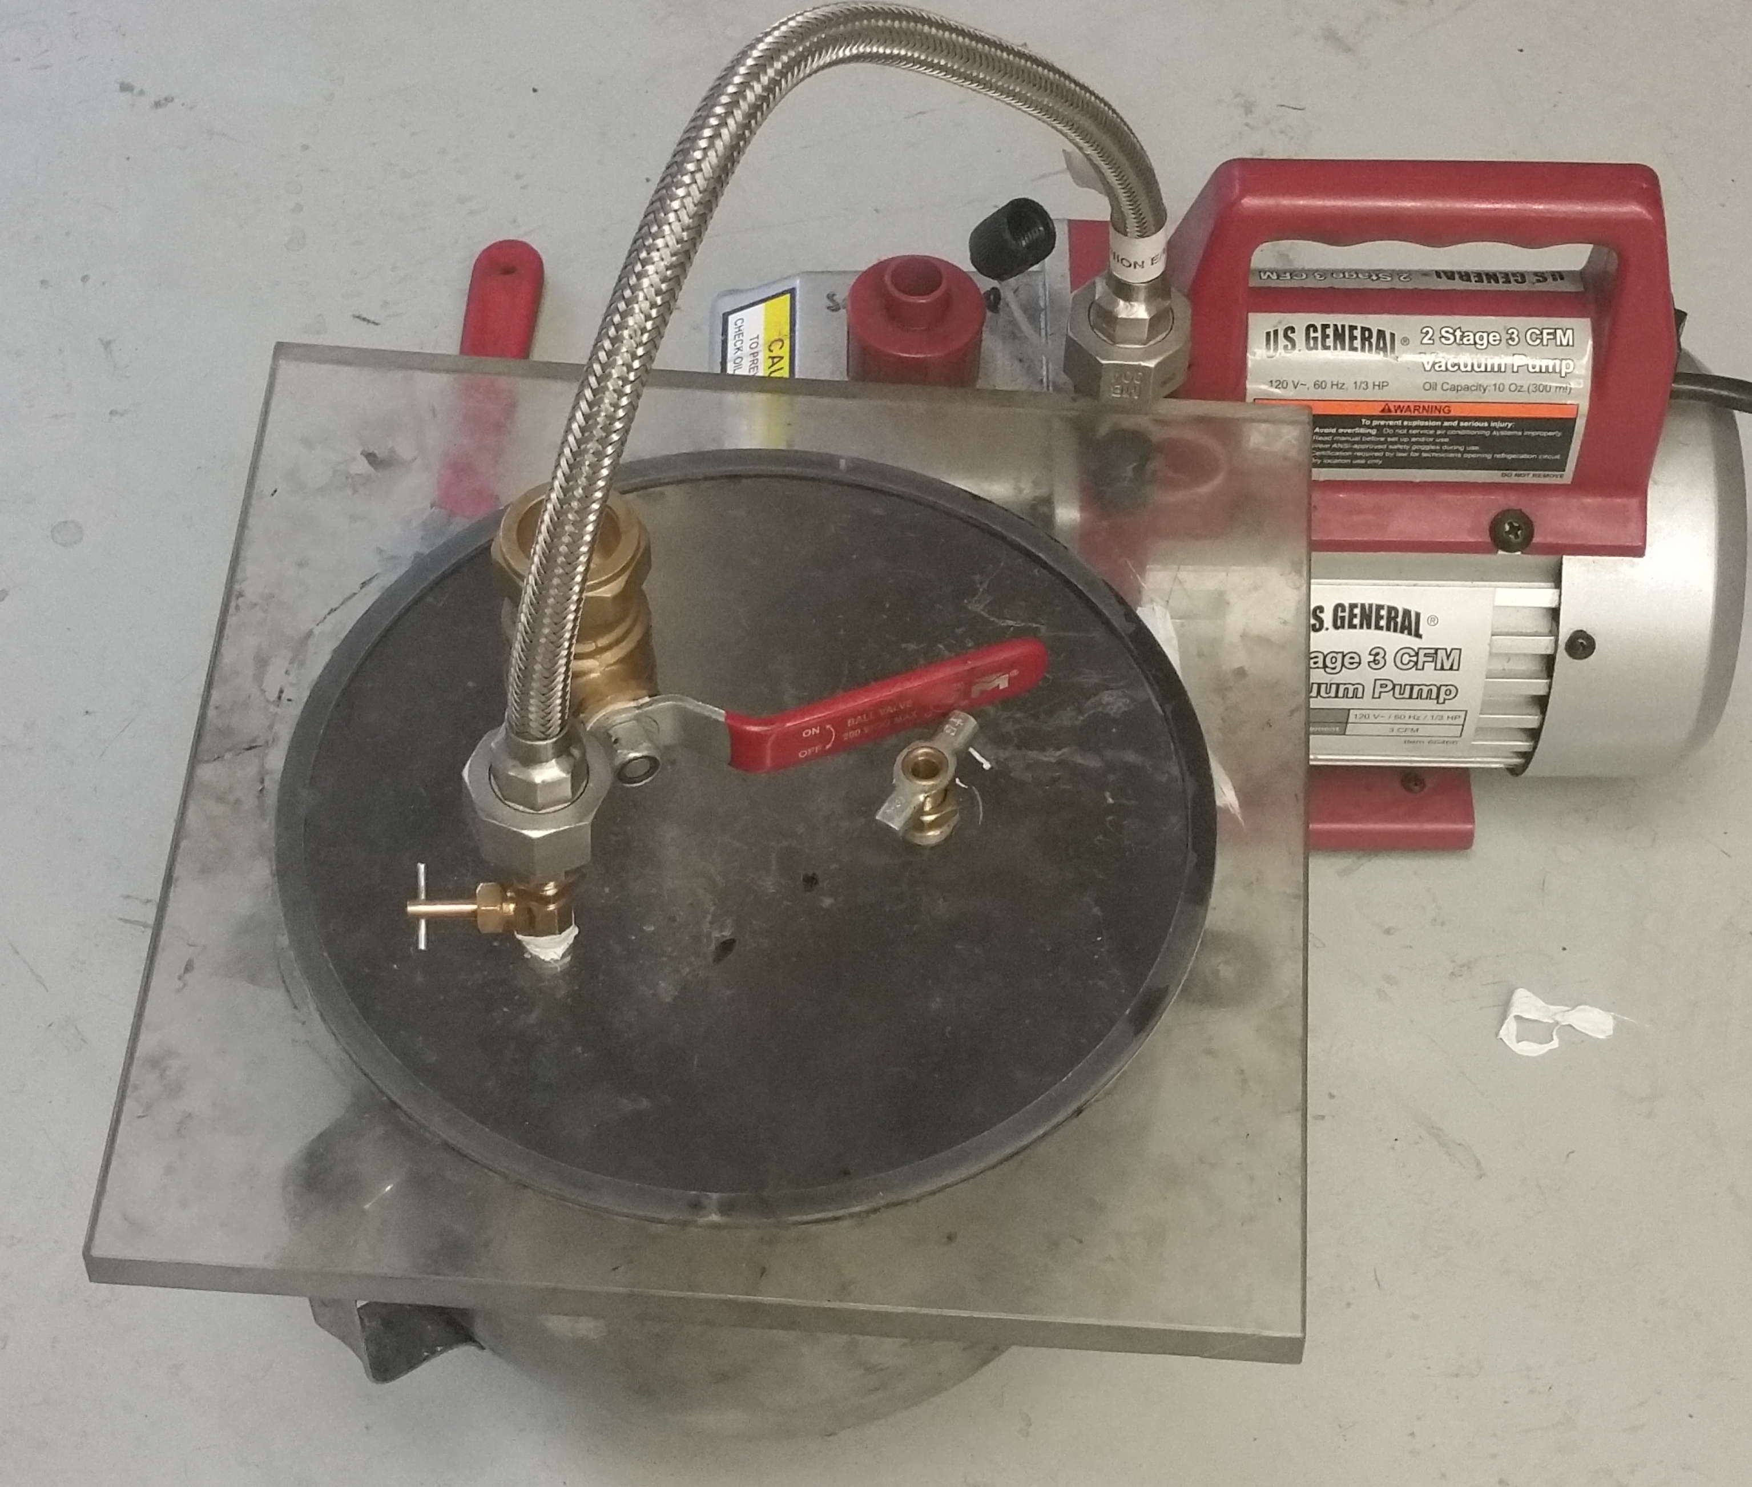
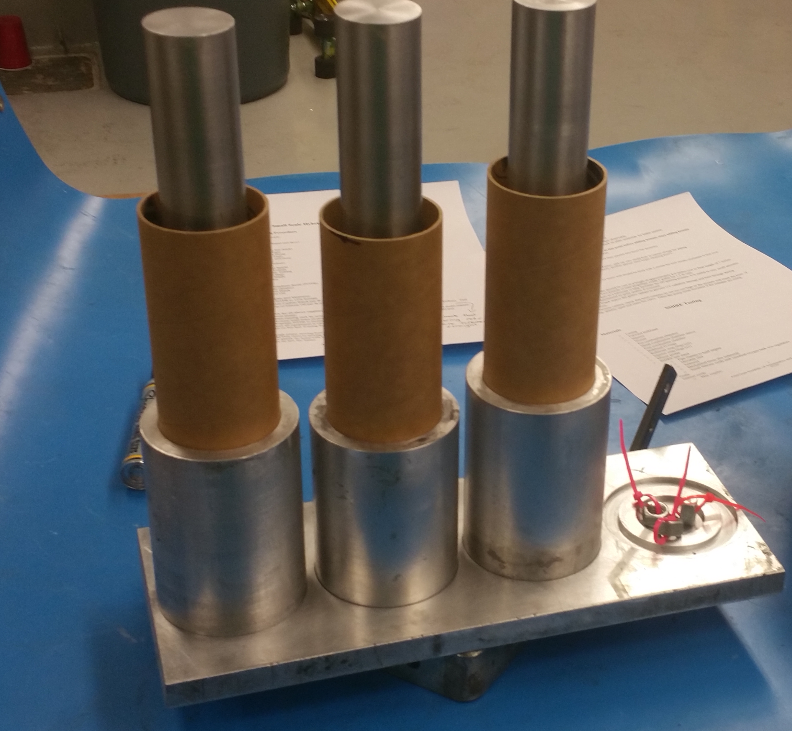
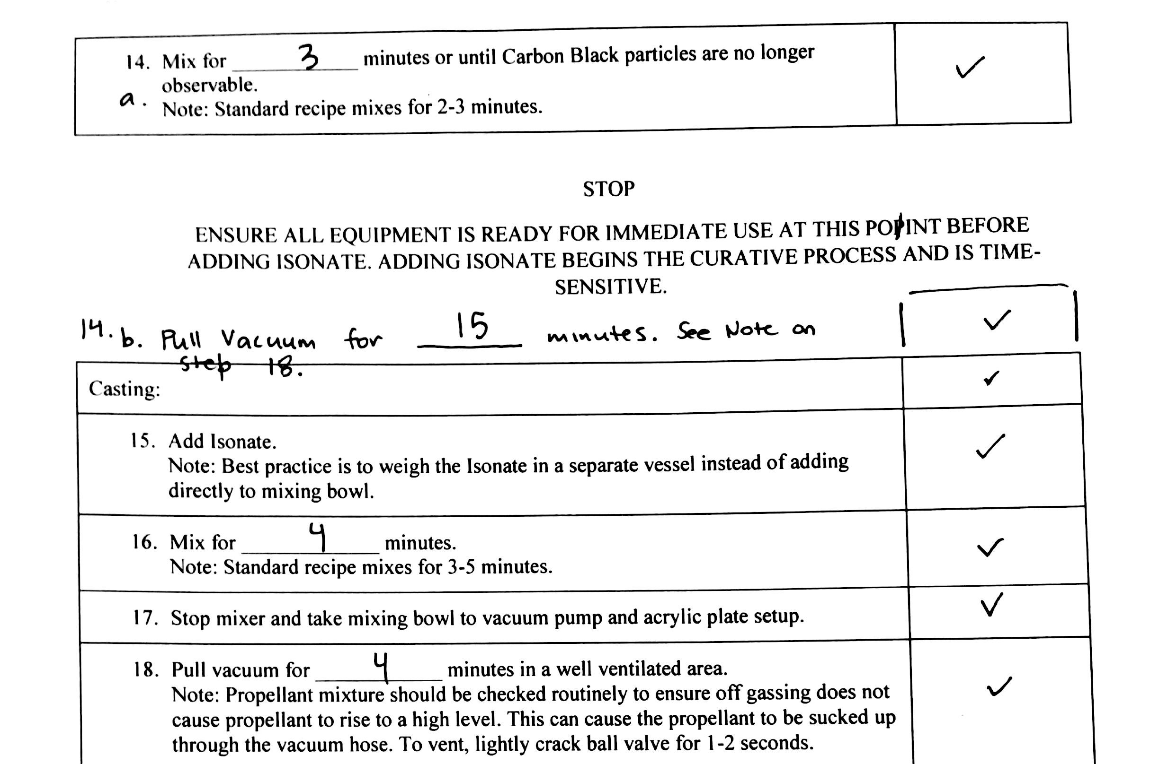
Casting Procedure
Mixing
Vacuum
Cast
Step-by-step casting procedures were developed to ensure every sample was identical.
Our HTPB hybrid rocket fuel is relatively easy to mix.

Slide 6
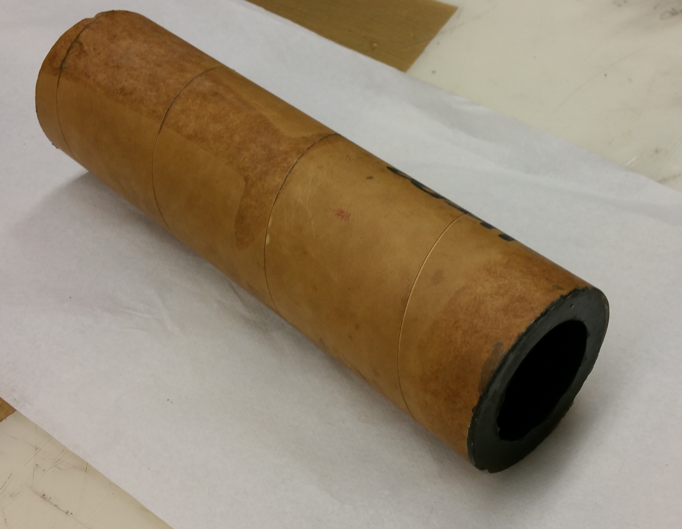
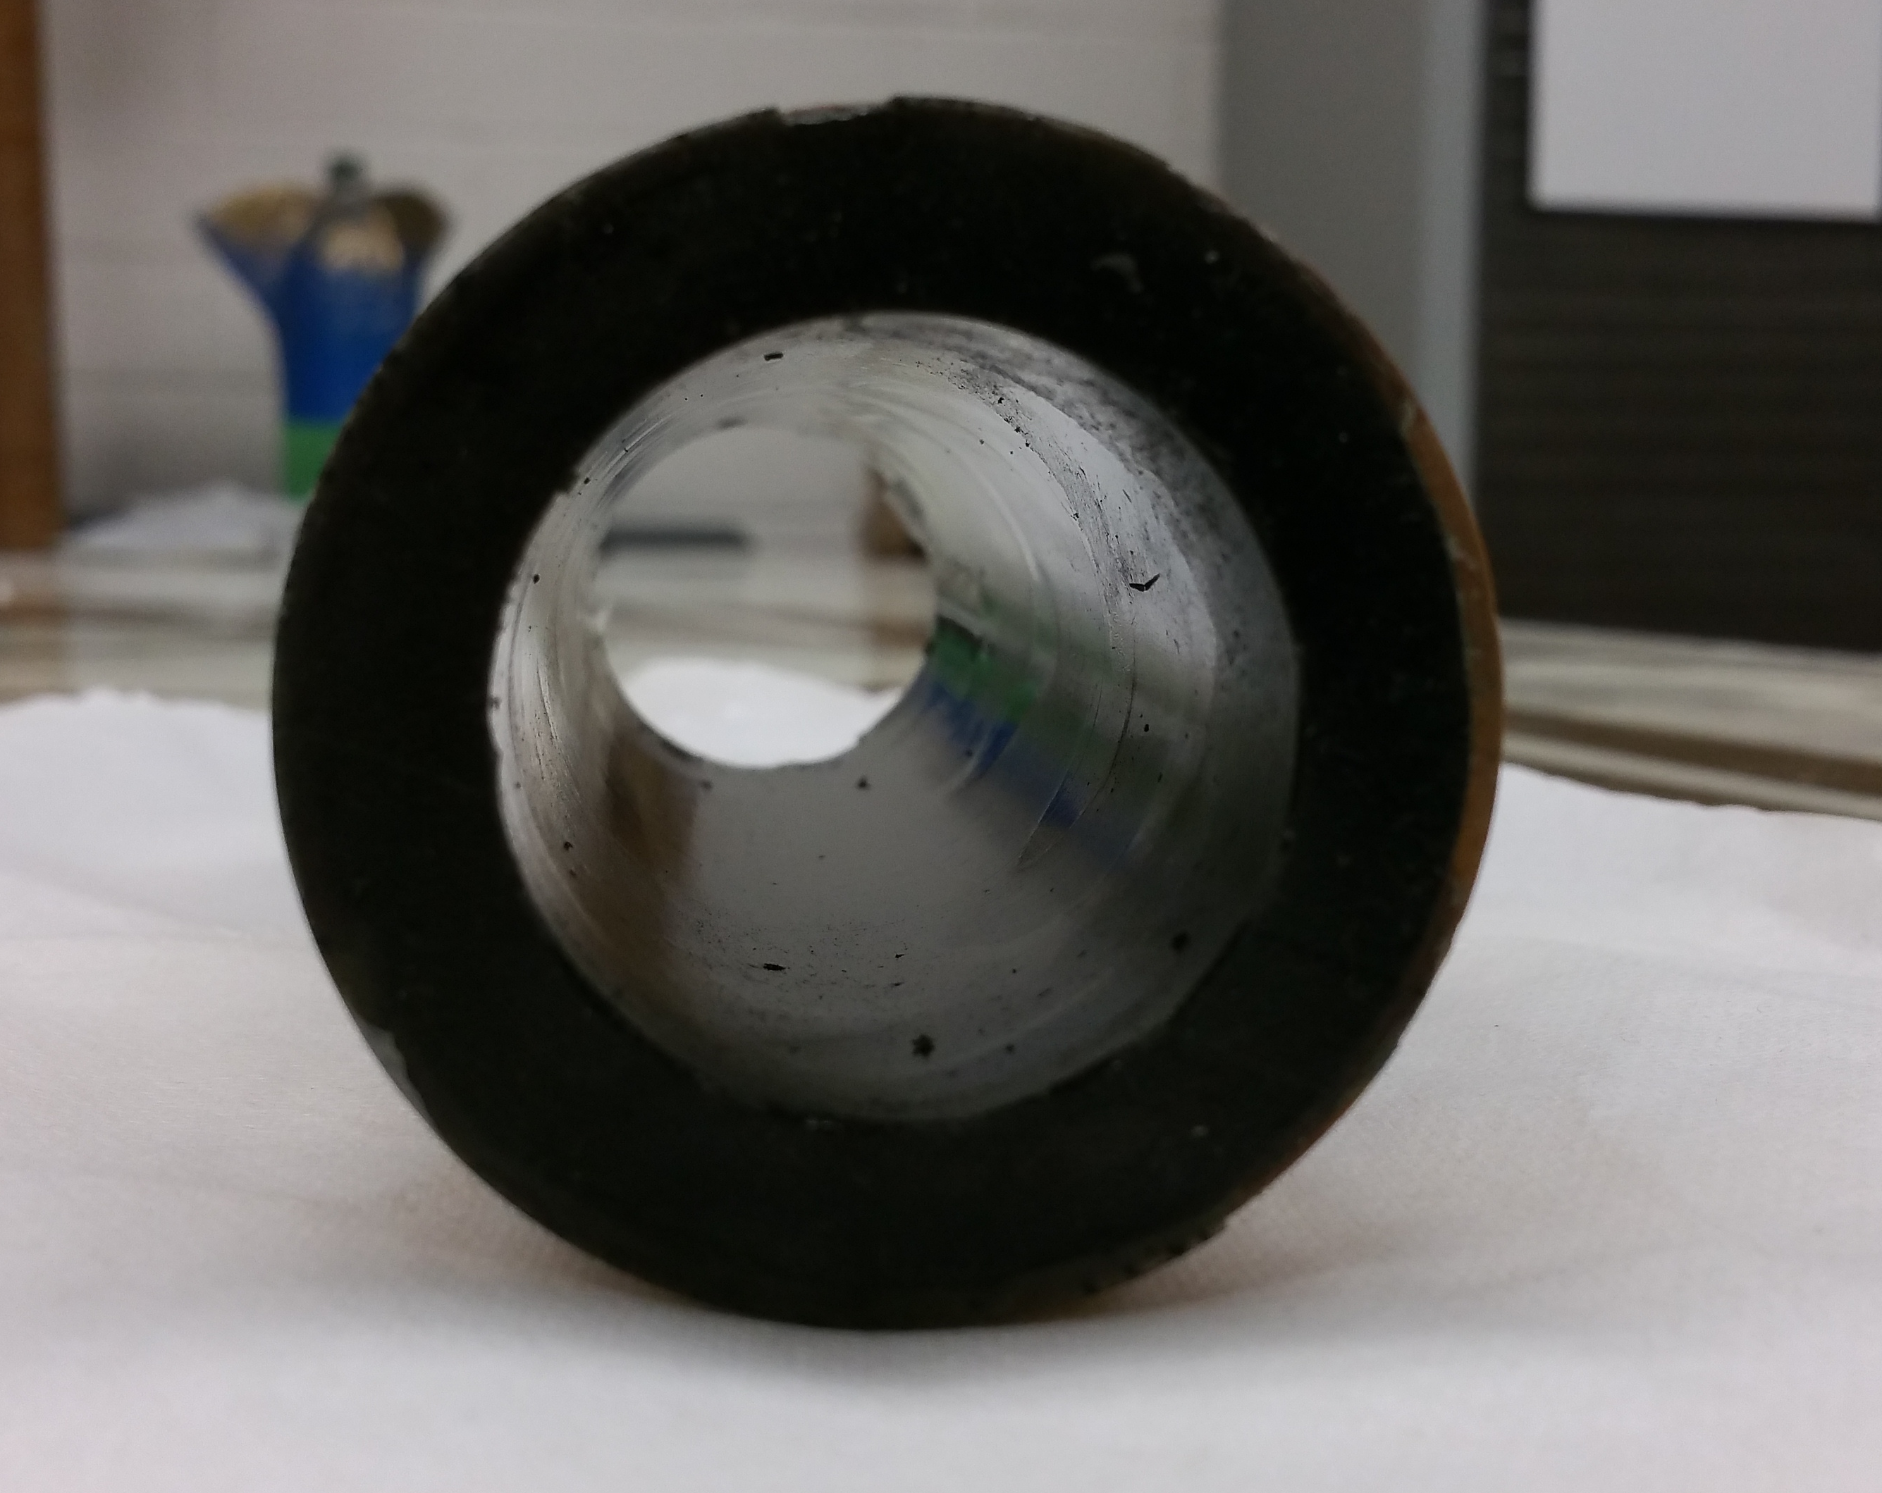
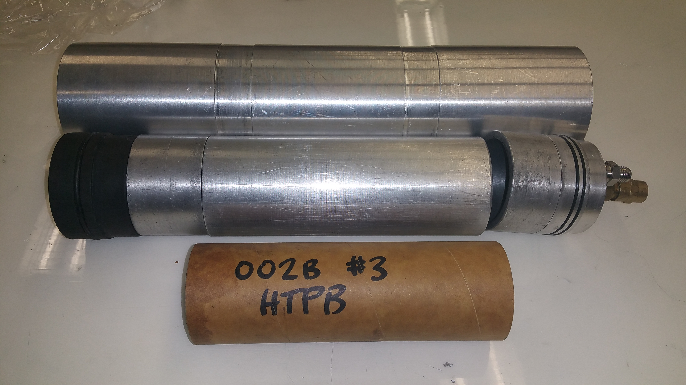
Casting Product
7” Long
1.5” Inner Diameter

Slide 7
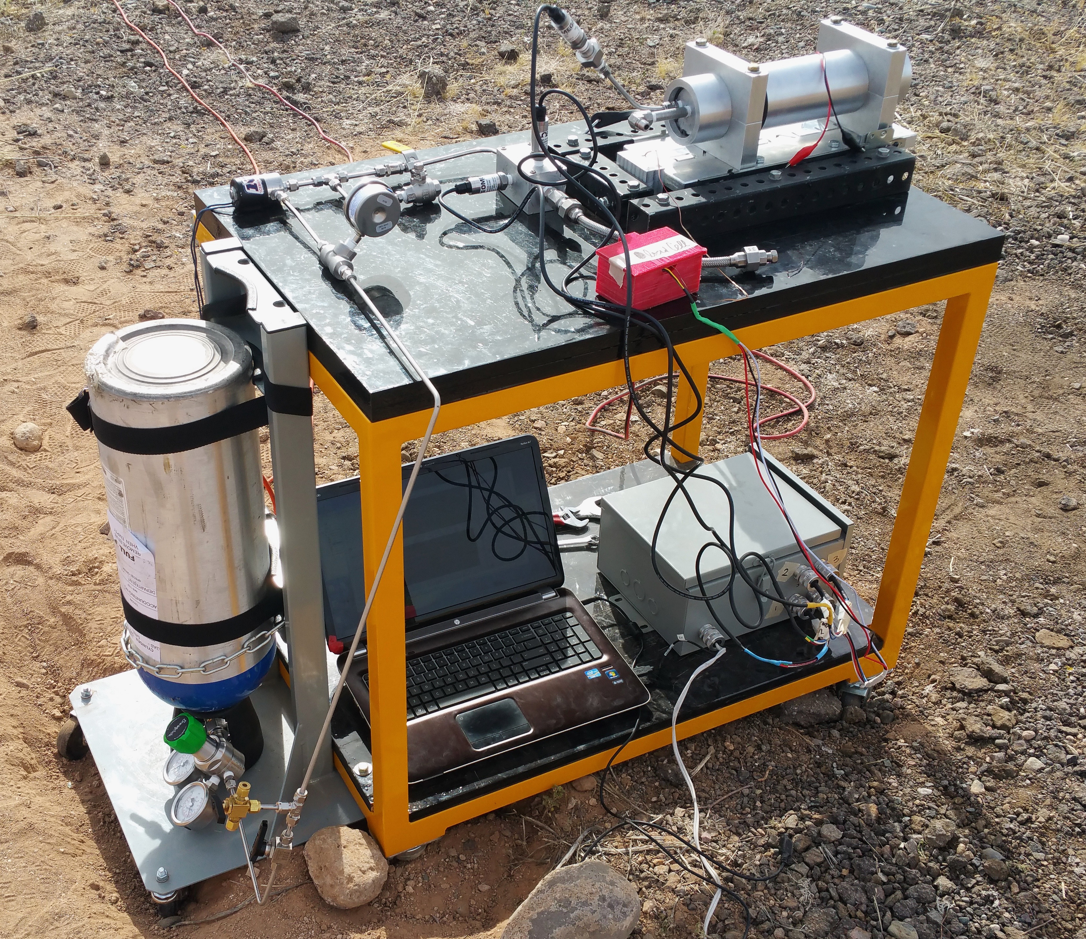
Test Cart Assembly
Combustion Chamber
Solenoid
Data Acquisition Equipment
Oxidizer Tank

Slide 8
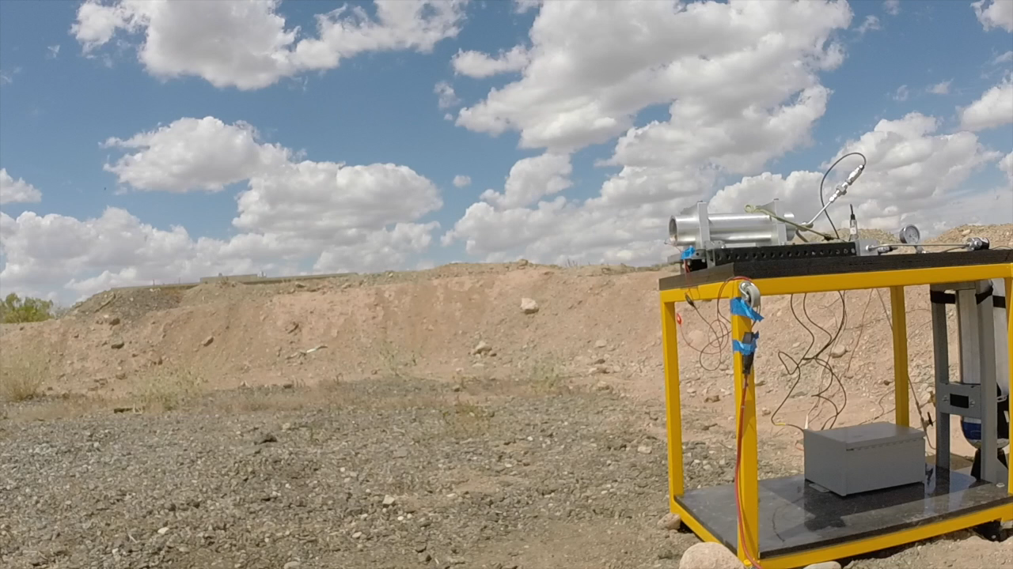
Preliminary Results

Slide 9
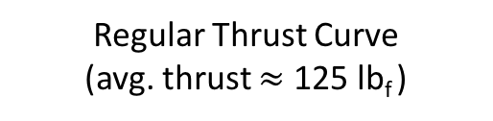
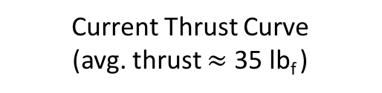
Preliminary Results Cont.
Regular Thrust Curve
(avg. thrust $≈$ 125 lb_{f} )
Current Thrust Curve
(avg. thrust $≈$ 35 lb_{f} )

Slide 10
Future Work
Before Further Testing:
Refit bulkhead for further firings
Re-machine swirl injector for HTPB O/F ratio
Develop consistent igniter formula
Testing:
Rerun ignition testing
Fire grains for aging characteristics testing

Slide 11
Thank You
With special thanks to Dr. John Rajadas, my mentor, the members of Daedalus Astronautics, NASA Space Grant, and the University of Arizona

